Slide 1
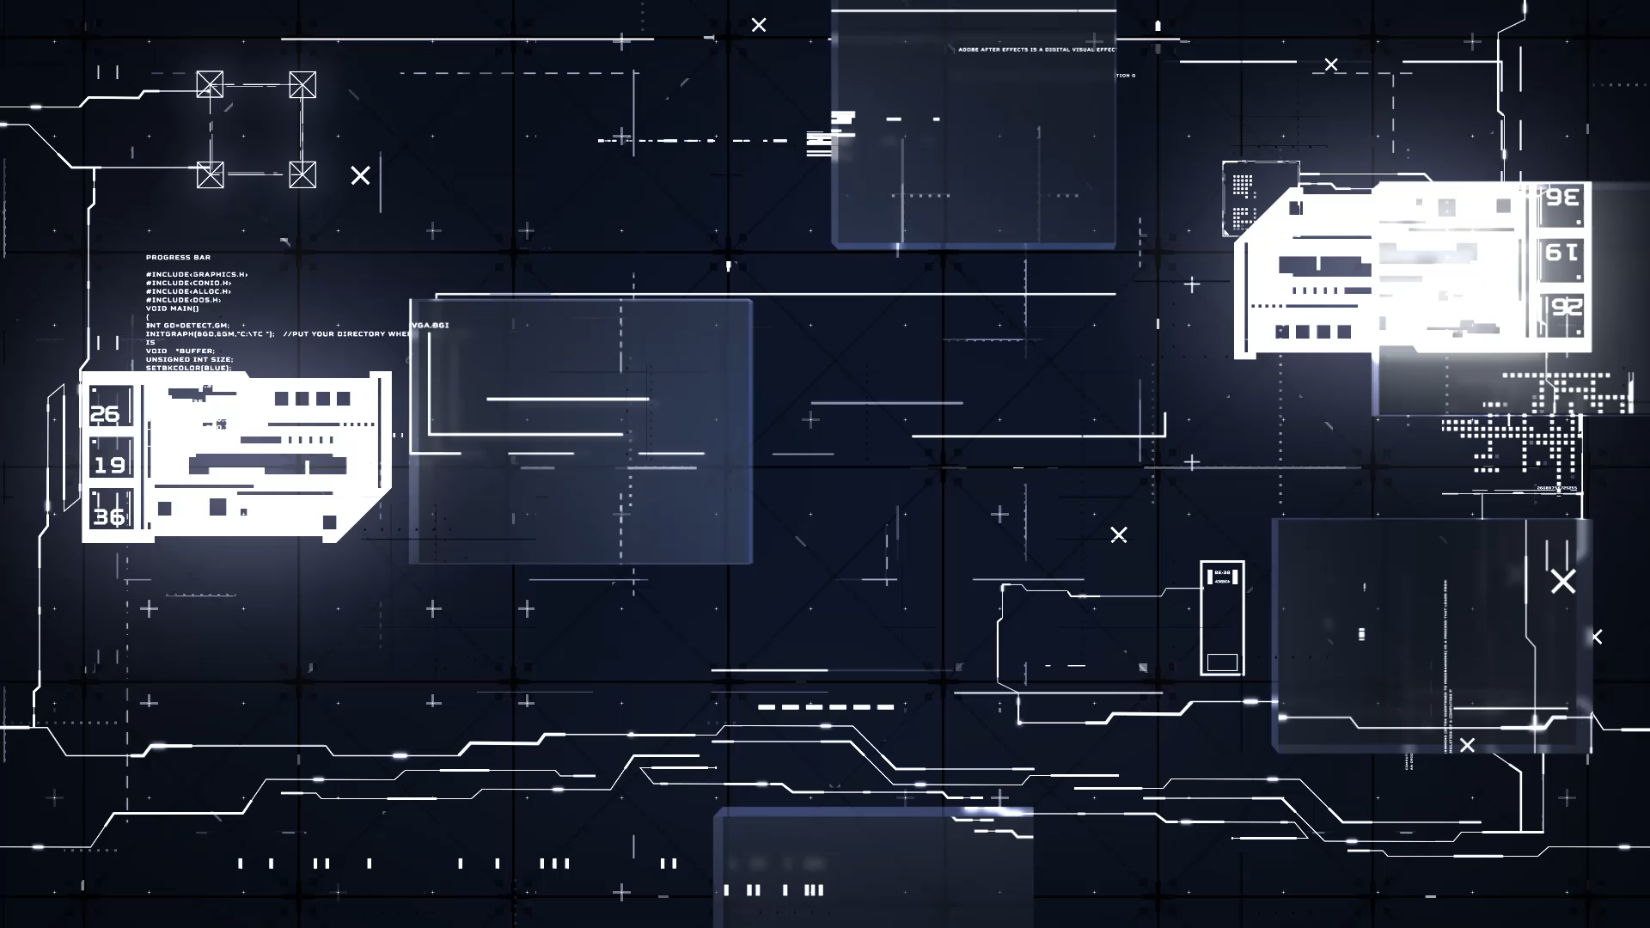

Slide 2
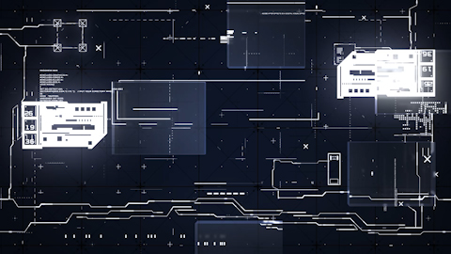
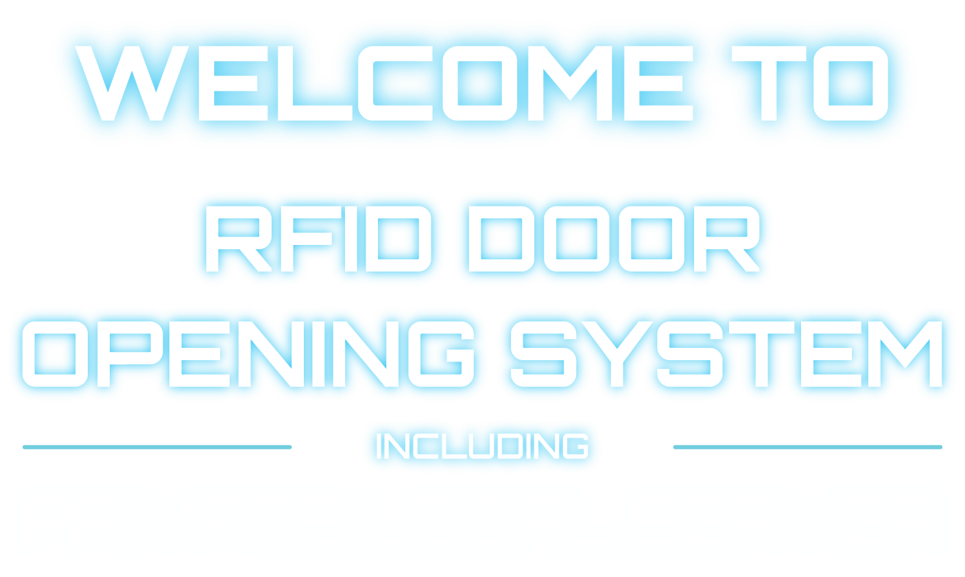

Slide 3
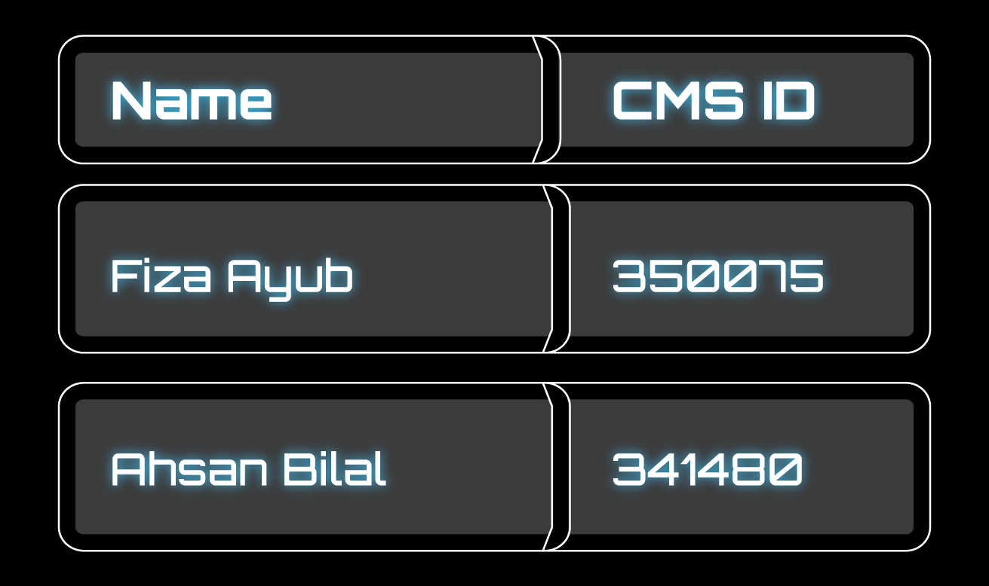

Slide 4
WHAT IS RFID?
Radio-frequency identification uses electromagnetic fields to automatically identify and track tags attached to objects.
An RFID system consists of a tiny radio transponder, and transmitter.

Slide 5
COMPONENTS USED:
• Atmega 16A
• LED Lights
• RFID Module MRC522
• Potentiometer
• LCD 16X2 Display
• Servo Motor
• NodeMCU ESP8266 Wifi Module
• Breadboard & Jumper Wires

Slide 6
SOFTWARE COMPONENTS
XAMPP LOCALHOST
ATMEL STUDIO
ARDUINO IDE
PROTEUS

Slide 7
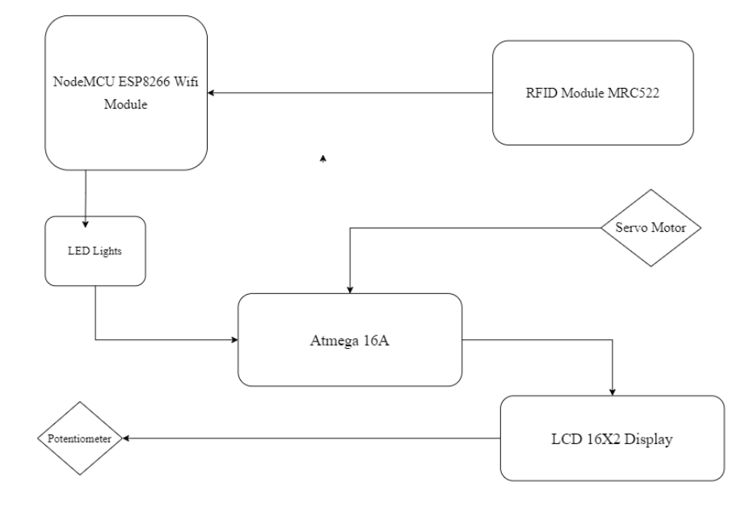

Slide 8
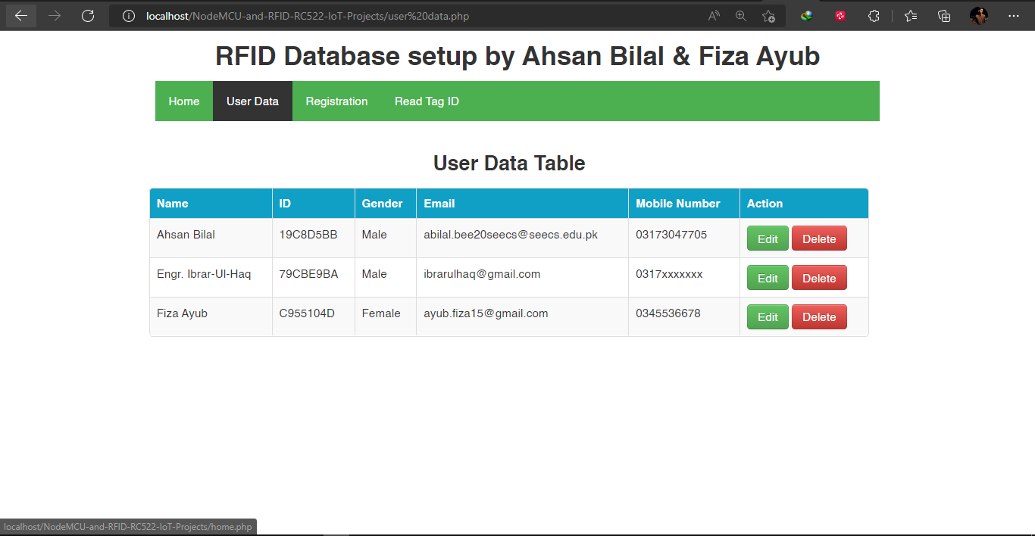
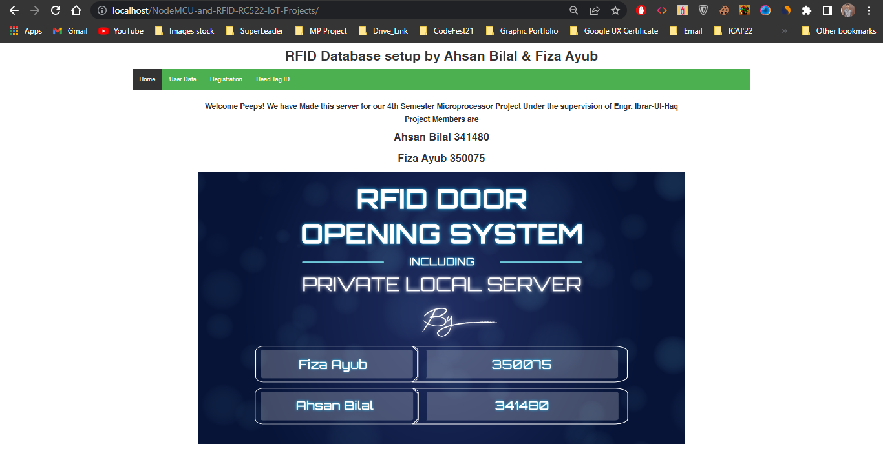
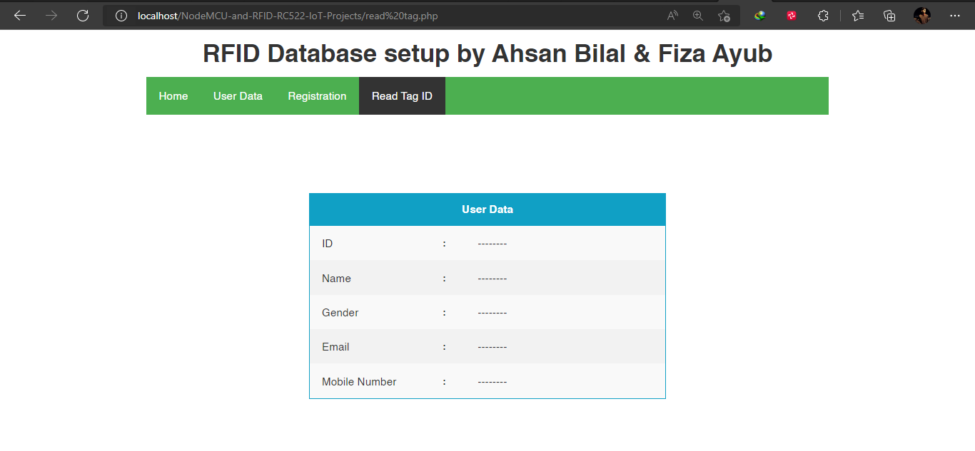
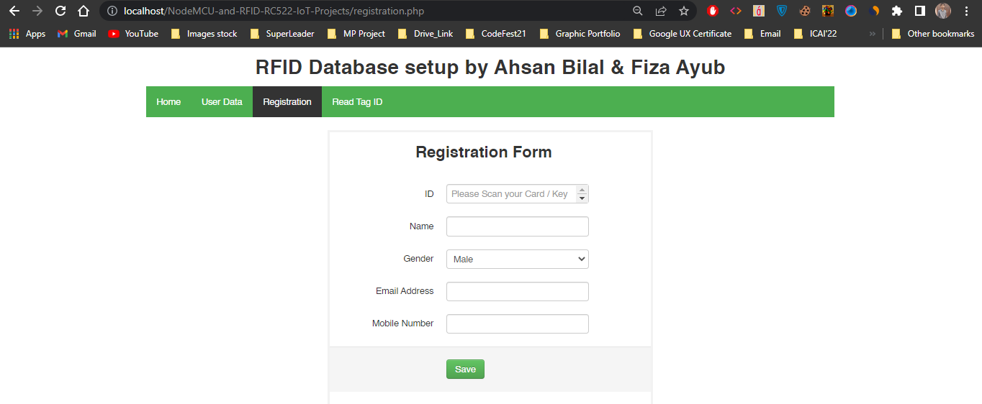

Slide 9
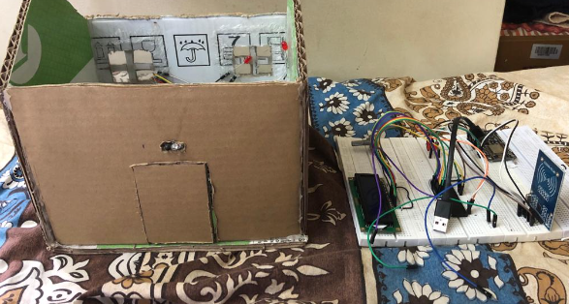
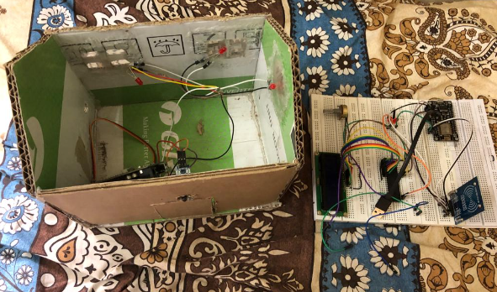

Slide 10
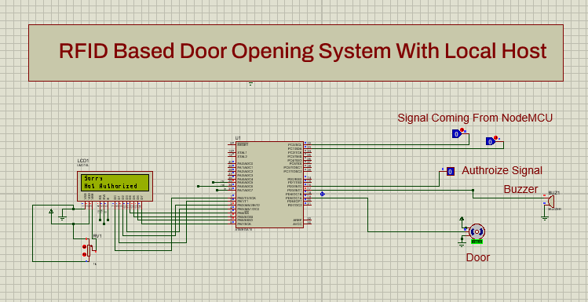

Slide 11
Future Recommentation
Use the general RFID EM-1 Module
All the computational analysis will be done Atmega16a.
Use more powerful and secure server for long distance security.
Various ports can be made for external use by increasing the external circuitry.

Slide 12
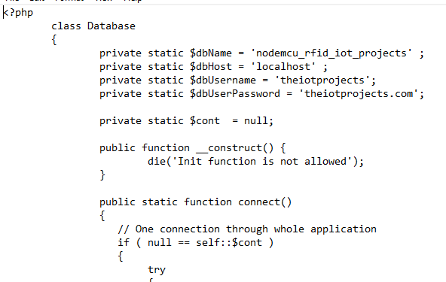
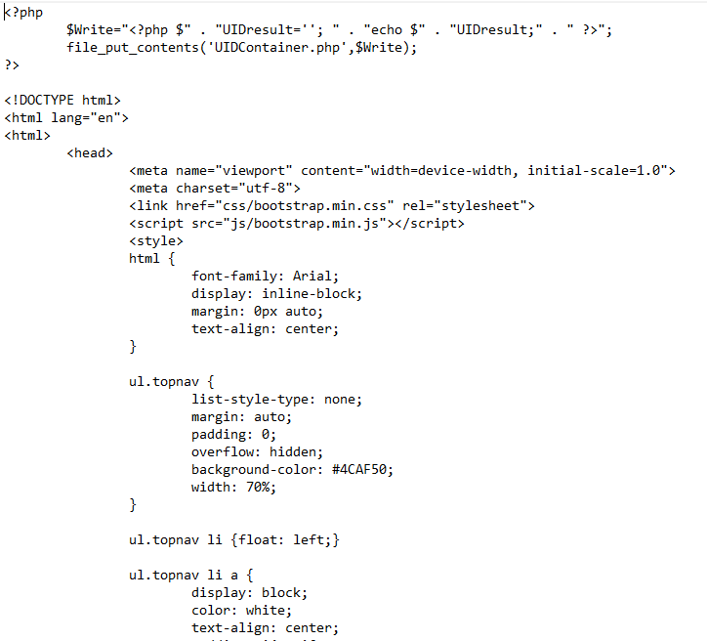
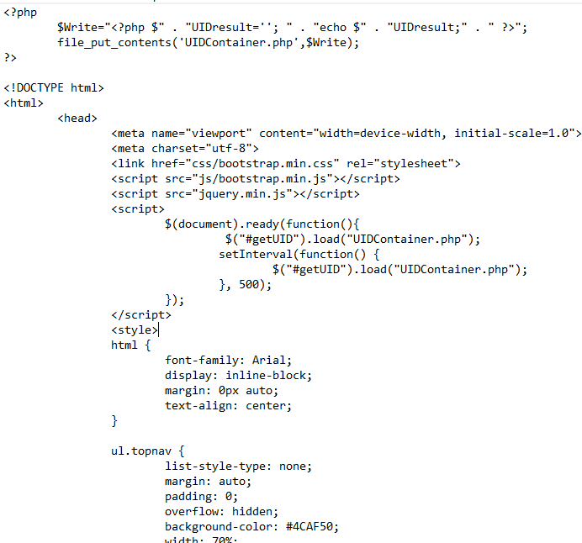

Slide 13
CONCLUSION:
When it comes to security, RFID door lock systems are very common for access control, as they provide a reliable, consistent experience with trackable data. Unlike other forms of traditional access control such as swipe cards, RFID locking systems are contactless, meaning that the credential doesn’t have to touch the reader for it to work.

Slide 14

Thanks You

